Slide 1

Museum of Discovery and Science MODS Poll
Group 2: Rebecca Russell, Daniel Feldan, Tiago Baptista

Slide 2
Purpose
Tool for Parents
Keep Children Interested in Learning
Provide information to the Museum of Discovery and Science
Notes:
Give parents a tool to use to learn which exhibits their child would enjoy the most.
Give The Museum of Discovery and Science a survey of the children who attend the museum that would show the museum which exhibits that are the most popular for specific age groups.

Slide 3
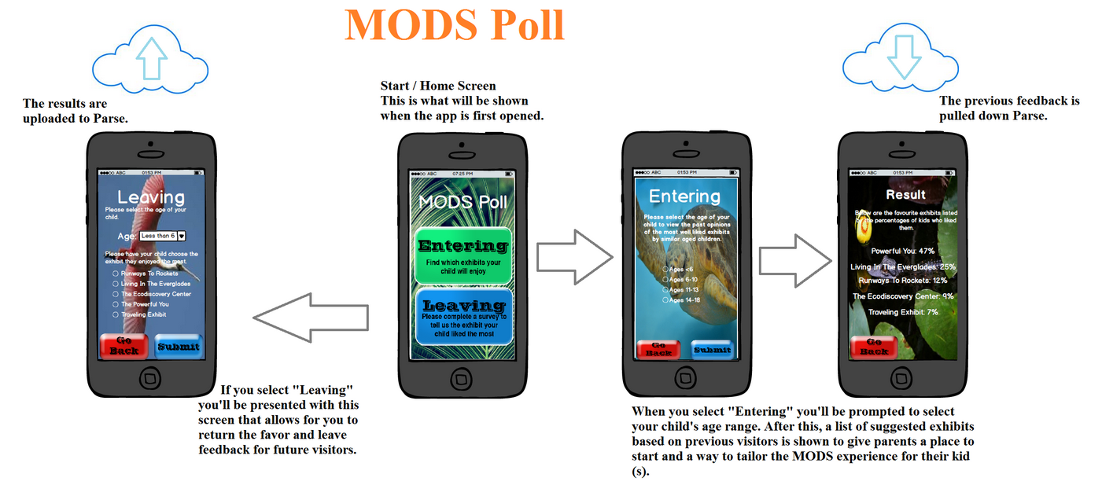
Storyboard

Slide 4
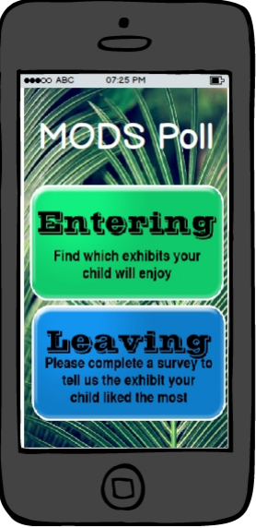
Menu
The Menu screen gives the user two options: Entering and Leaving
The Entering screen leads the user to a screen that asks the user the age of the child to determine the exhibits he/she would like the most.
The Leaving button leads the user to the Leaving screen which asks the user the age of the child and the exhibit he/she liked the most.

Slide 5
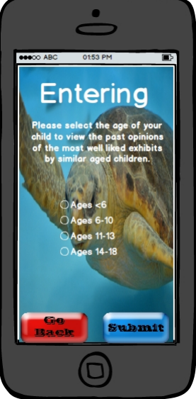
Entering Screen
The Entering screen prompts the user to click the age of their child to determine the most popular exhibits for that age group.
When the user clicks submit, the user will see these exhibits.
The user can click Go Back to return to the main menu.

Slide 6
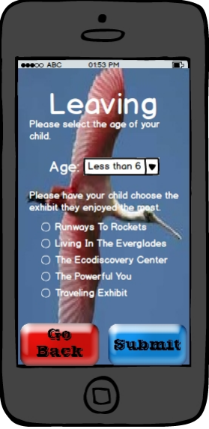
Leaving Screen
The Leaving Screen prompts the user to choose the age of the child and select the exhibit the child enjoyed the most.
This information is sent to Parse.com which collects all of the survey information in one large database.
When the user clicks submit, a pop up screen appears thanking them for participating in the survey.
The user can click Go Back to return to the main menu.

Slide 7

Uploading Code

Slide 8
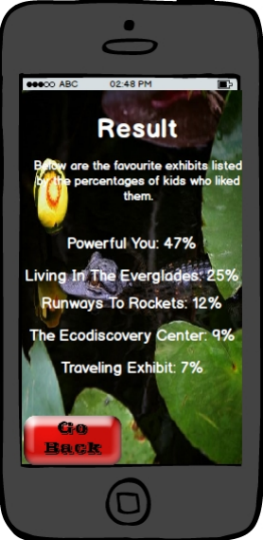
Results Screen
This screen presents a list of the exhibits at the Museum of Discovery and Science with the percentage of children in the selected age group that chose the respective exhibit as their favourite.
The user can click Go Back to return the Entering screen to input another age group.

Slide 9
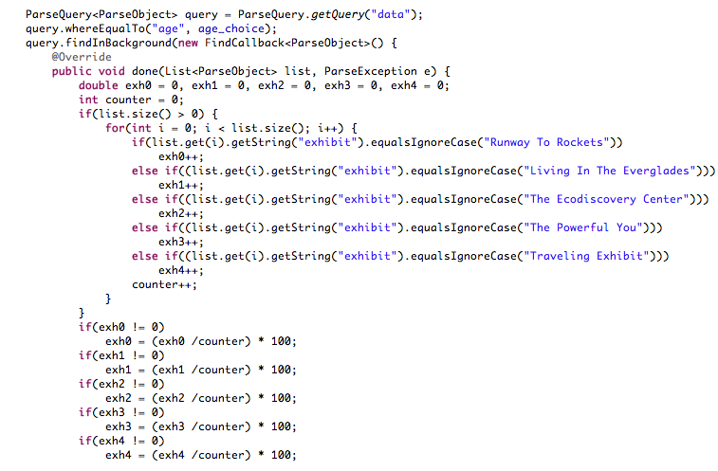
Results Code

Slide 10
Informational Aspect
Parents use the suggested exhibits screen to get information about the museum and popular exhibits.
The Museum of Discovery and Science can use the information from the survey data to further enhance the museum.
Notes:
Parents can use the information they gain from the “Entering” screen to guide their way through the museum and get the best experience possible.
The Museum of Discovery and Science could use the results of the “Leaving” screen survey to further enhance the quality of the exhibits. They could start to enhance the exhibits to attract the attention of all age groups of children.

Slide 11
Educational Aspect
High level of interest
Optimum state for learning new material
Notes:
The app we are proposing will help the children attending the museum maintain constant interest in the information provided at the museum. This will occur through the use of the “Entering” screen. Since the parents of the child will know where their children will be happiest, the child will not become bored and want to end their trip early. By remaining interested, the children will focus more on the exhibits and get the most educational material out of their trip to the museum.

Slide 12
Overall Benefits
The museum will be able to entertain their guests more efficiently.
The children will get the best educational experience from all the Museum of Discovery and Science has to offer.

Slide 13
Questions or Comments?

